Slide 1
SQL: Assignment
University
Management System

Slide 2
Introduction
Universities manage data related to students, faculty, courses, and departments.
Proper management and analysis of this data is important for academic planning.
This project uses a University Management System database and SQL queries to analyze student performance, enrollments, and workload.

Slide 3
Project Objectives
• Track student enrollments & performance
• Analyze course popularity
• Evaluate professor & department workload
• Support academic decision-making

Slide 4
Database Schema
Students
Courses
Professors
Enrollments
Departments
ProfessorDepartments

Slide 5
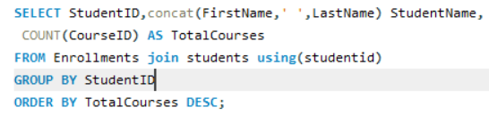
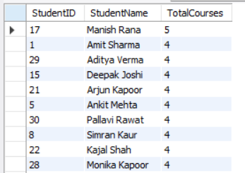
Q1: Students with Highest Enrollments in course
SQL Query:
Result: 'Manish Rana’ Highly enrolled students show strong academic engagement.

Slide 6
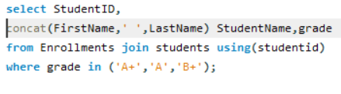
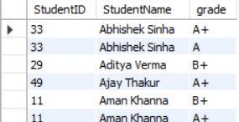
Q2: High Grade Students
SQL Query:
Result: These students are eligible for merit-based scholarships.

Slide 7
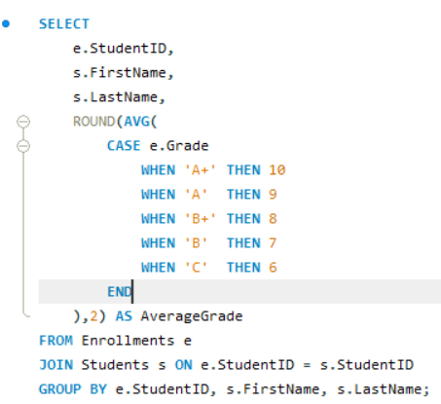
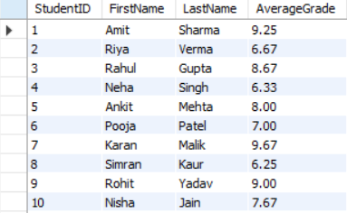
Q3: Average Grade per Student
Result: Helps identify students needing academic counseling.

Slide 8
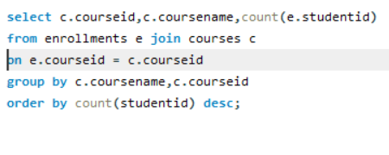
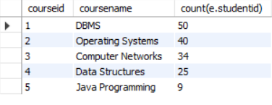
Q4: Top 5 Most Enrolled Courses
SQL Query:
Result: Popular courses reflect student demand.

Slide 9
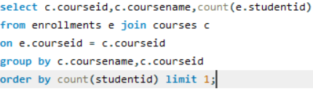

Q5: Course with low enrollment numbers
SQL Query:
Result: Indicates workload or popularity.

Slide 10
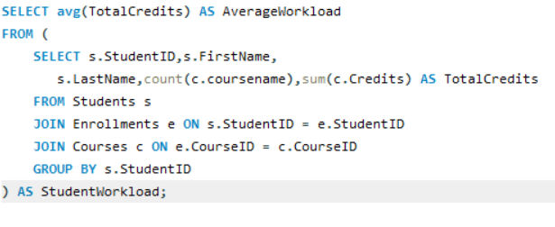

Q6: Average workload by Total Credits as per Student
SQL Query:
Result: workload balanced.

Slide 11
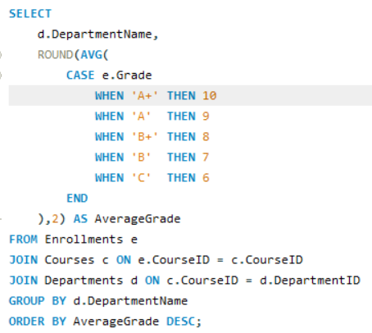
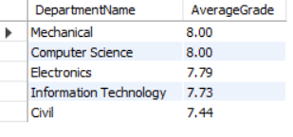
Q7: Average grade distribution across all departments
SQL Query:
Result: Mechnical departments shows best performance.

Slide 12
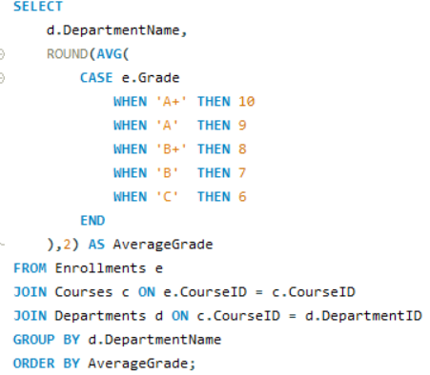
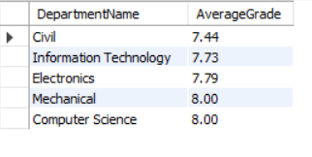
Q8: Difficult courses
SQL Query:
Result: Civil deparment fount difficult course.

Slide 13
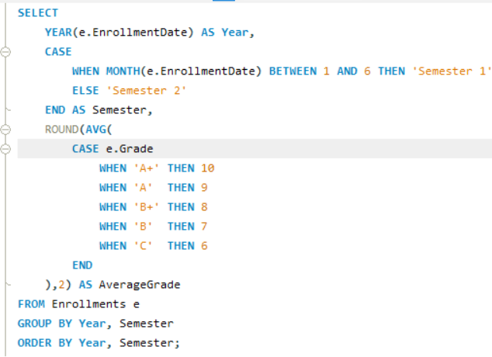

Q9: Grade trends over time
SQL Query:
Result:Course adaptation by students

Slide 14
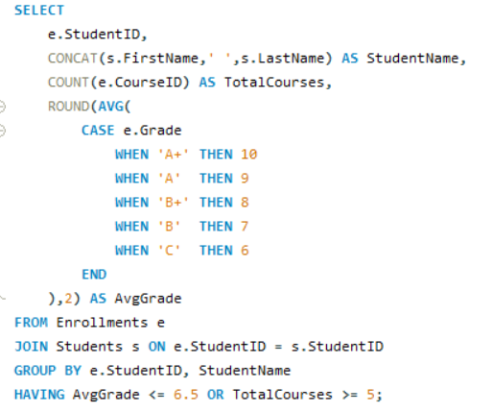
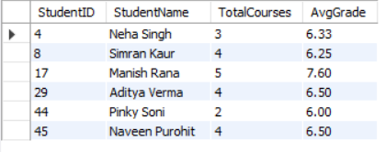
Q10: Risk of failing based on their grades and number of courses taken
SQL Query:
Result: Above students have a risk of failing.

Slide 15
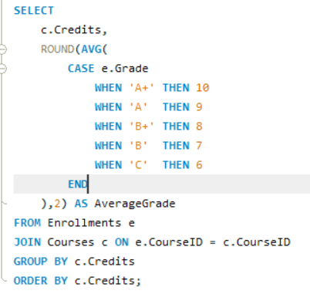

Q11: Students enrolled in higher-credit courses tend to achieve better grades.
SQL Query:
Result: False, course with higher credit are also average as other courses.

Slide 16
Conclusion
SQL-based analysis helps universities improve academic planning,
identify performance trends, and optimize resources.

Slide 17
Thank You
Thank you for your time.
Any Questions?

